Slide 1




Data Preprocessing

Slide 2

Objective & Outline
Page 01

Slide 3

Objective & Outline
Objective
To understand how important data preprocessing is in term of building machine learning model.
Understand & prepare the datasets for machine learning modeling process
Important task technique that transforms raw data into a more understandable, useful and efficient format
Outline
What is Data Preprocessing ?
Why Data Preprocessing?
Data Preprocessing
Data Cleaning
Data Transformation
Feature Analysis
Page 02

Slide 4
What is Data Preprocessing?
Page 03

Slide 5

What is Data Preprocessing?
In any Machine Learning process, Data Preprocessing is that step in which the data gets transformed, or Encoded, to bring it to such a state that now the machine can easily parse it. In other words, the features of the data can now be easily interpreted by the algorithm.
Page 04

Slide 6

Why Data Preprocessing?
Data in the real world is dirty
Incomplete: lacking attribute values
Noisy: Containing errors or outlier
Categorical or Continuous: Data represents categorical or continuous values that are not standardized
Page 05

Slide 7

Data Cleaning
What we will do in the data cleaning:
Fill in missing values
Eliminate noise data
Identify or remove outliers
Deal with inconsistencies
Page 06

Slide 8

Quiz Session

Slide 9
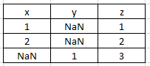
Quiz
Write Syntax to find how many NaN data Per-Columns from the table below.

Slide 10

Data Transformation
Data transformation is the process of converting data from one format or structure into another format or structure.
Purpose :
To transform data into form that can be learned easier by computer
To simplify data by decreasing its value scale
To standardize data type (categorical or numerical)
Page 07

Slide 11
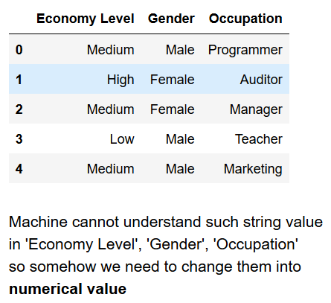
Data Transformation (categorical)
The idea is to make all features that contain categorical data for having numerical information. Generally there are 2 methods that can be used:
Label Encoder
One Hot Encoder
Page 08

Slide 12
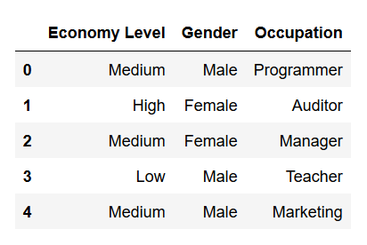
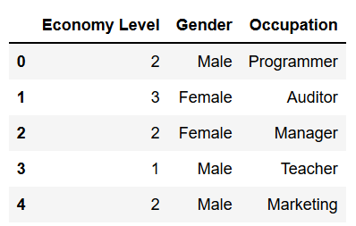
Data Transformation (categorical)
Label Encoder
Page 09

Slide 13
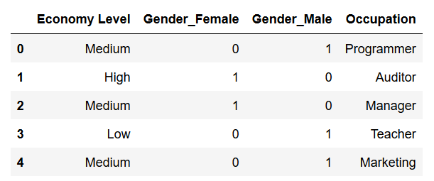
Data Transformation (categorical)
One Hot Encoder
Page 10

Slide 14
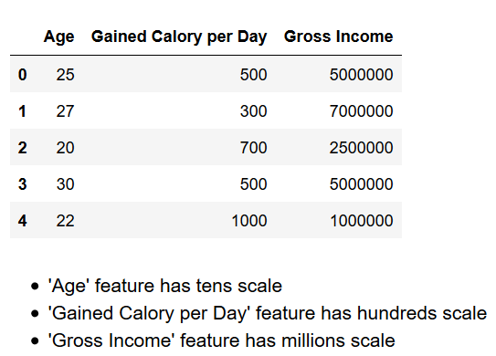
Data Transformation (numerical)
The idea is to make all feature that contain numerical data for having same scale. Generally there are 2 methods that can be used:
Standard Scaler
Min-Max Scaler
Page 11

Slide 15
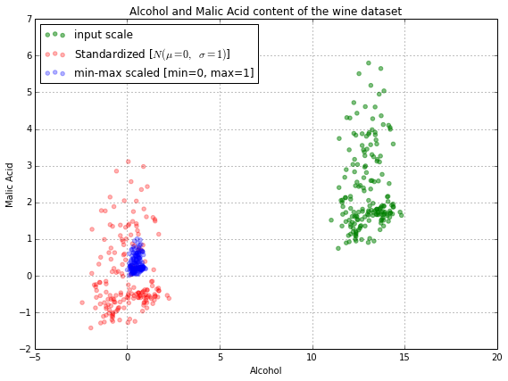
Data Transformation (numerical)
Standard Scaler transform data distribution into normal distribution
Min Max Scaler transform data range into 0 ~ 1
Rule of thumb:
Use Min Max Scaler as the default if you are transforming a feature
Use Standard Scaler if you need a relatively normal distribution
Page 12

Slide 16
Feature Analysis
Feature Selection | Feature Engineering | Feature Extraction
Based on domain knowledge Exclude unnecessary features Heatmap and many other visualization techniques support | Based on domain knowledge Generating new feature from other related datasets | Keep all information from all feature before extracting the information Popular techniques such as Principal Component Analysis (PCA), Linear Discriminant Analysis (LDA) and Auto Encoder (Neural Network Approach)
Page 13

Slide 17
Quiz Session
Page 03

Slide 18
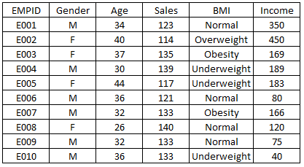
Quiz
In your opinion, which column should be transformed from the BMI table below.?
Page 06

Slide 19
Terima Kasih!
Indonesia AI | AI for Everyone, AI for Indonesia
contact@aiforindonesia.org

